Slide 1





Article
Category Prediction
Under the guidance of
Ms. Anita Budhiraja
Dr. Sarwan Singh
01

Slide 2


Overview
Introduction
Understanding the Dataset
About the Dataset
Description of Dataset
Web Application Development using Flask
Conclusion and Future Enhancements
02

Slide 3

Introduction
Article category predictor is a machine learning tool that classifies articles into predefined categories like tech, sports, politics, entertainment, and business. By analyzing the text, the model predicts the most relevant category, enhancing content organization and retrieval. This technology is crucial for personalized content delivery and efficient information management.
03

Slide 4
Understanding the Dataset
Data Sources
Features
Target Variable
The dataset comprises articles from various online publications, covering topics across tech, business, sports, entertainment, and politics.
The articles are characterized by attributes such as article text.
The goal is to predict the category of each article based on the available features.
04

Slide 5
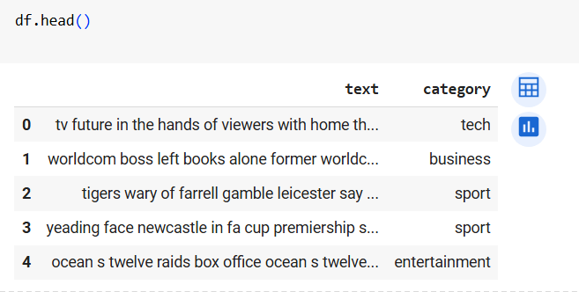
About the Dataset
Balanced Representation
The dataset contains a roughly equal number of articles across the five categories, ensuring a fair and unbiased analysis.
Dataset Link
https://raw.githubusercontent.com/Nishantkumar1265/article/main/bbc-textclassification.csv
05

Slide 6

Description of Dataset
We’ll use a public dataset from the BBC comprised of 2225 articles, each labeled under one of 5 categories: business, entertainment, politics, sport or tech.
The dataset is broken into 1780 records for training and 445 for testing. The goal will be to build a system that can accurately classify previously unseen news articles into the right category.
X_train, X_test, y_train, y_test = train_test_split(X, y, test_size=0.2, random_state=42)
06

Slide 7
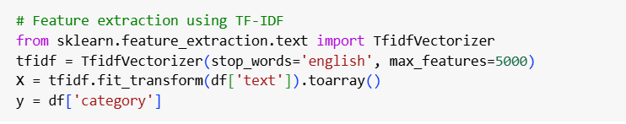
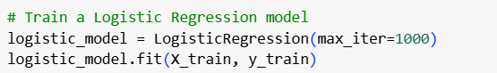
Logistic Regression Model
Feature Engineering
1
Transform the textual data into numerical features suitable for the logistic regression algorithm.
Model Training
2
Train the logistic regression model on the prepared dataset to learn the patterns and relationships.
Model Optimization
3
Fine-tune the model's hyperparameters to improve
its performance on the classification task.
07

Slide 8



Web Application Development
using Flask
User Input
Prediction
Explanation
Allow users to enter the article to get its category prediction.
Display the predicted article category based on the user's input and the trained Logistic Regression model.
Provide additional information and guidance to help users understand the predicted article category.
Customer Acquisition Cost
Customer Satisfaction
08

Slide 9
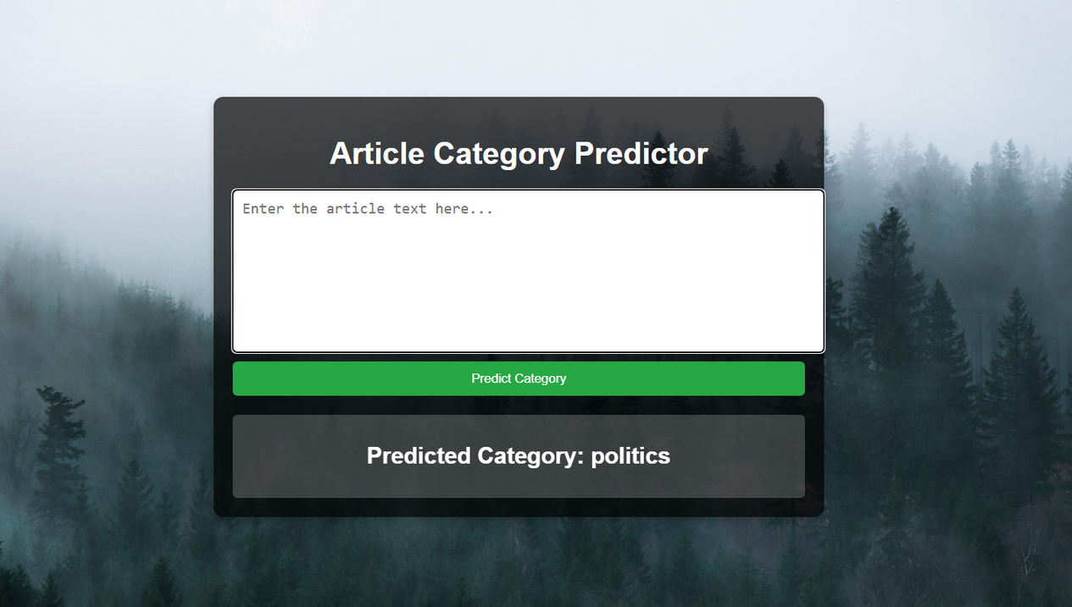



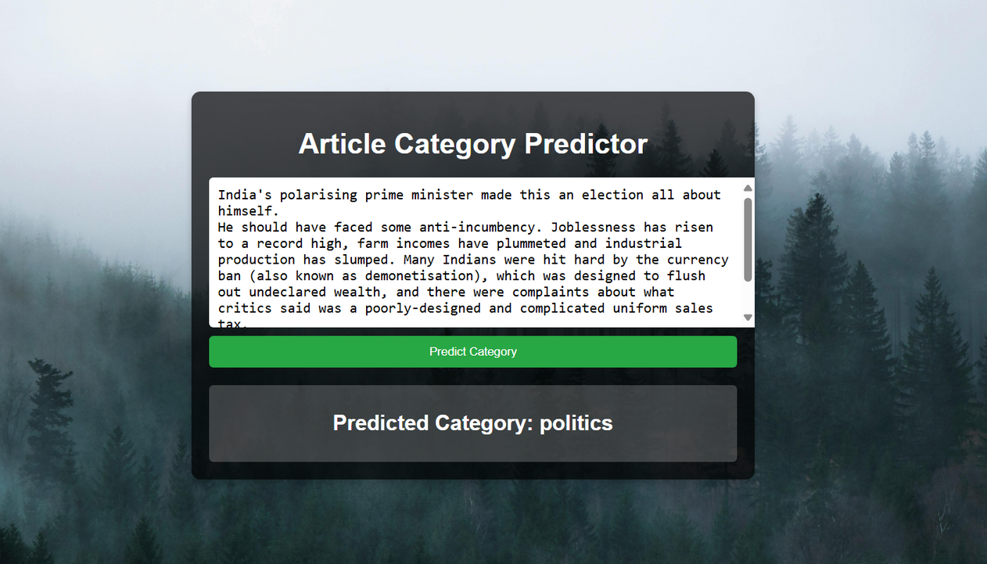

09

Slide 10





Conclusion and Future Enhancements
Key Insights
Model Performance
Future Enhancements
Logistic regression is the best model for our dataset with an accuracy of 97%
Discuss the overall effectiveness of the logistic regression model in predicting article categories.
Explore potential improvements, such as incorporating additional features or exploring alternative models such as Naves Bayes.
10

Slide 11



THANK YOU!
Nishant Kumar
Sonali
11

